Slide 1
Classical Simulation of Quantum Circuits Quantum Information and Quantum Computing Manuel Rudolph 16.01.2023

Slide 2
Why I chose this topic
Learn about state-of-the-art simulation techniques
Verifying performance of near term quantum algorithms
Larger scales simulations
Test noise resilience
Learn the Julia programming language
Contribute to the community

Slide 3
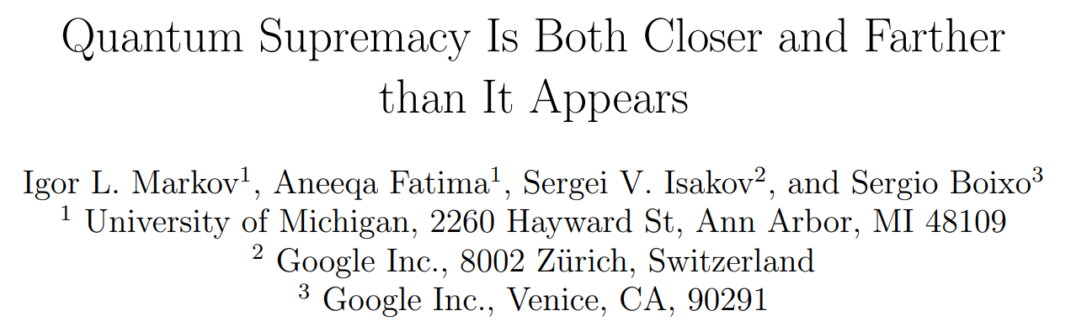
arXiv:1807.10749

Slide 4

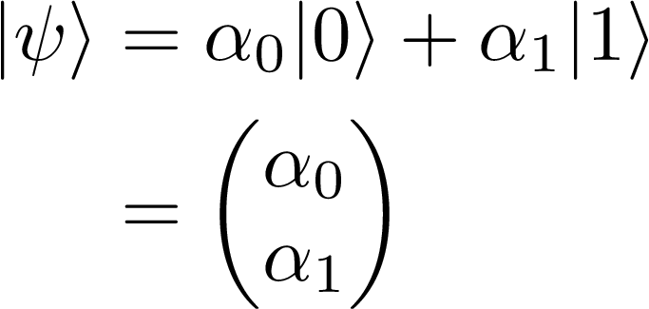


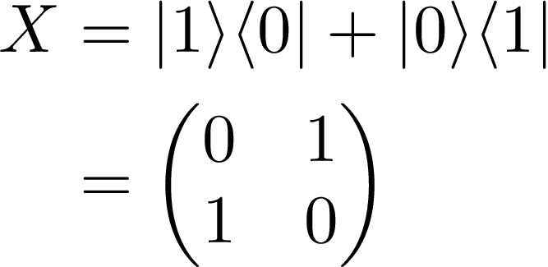
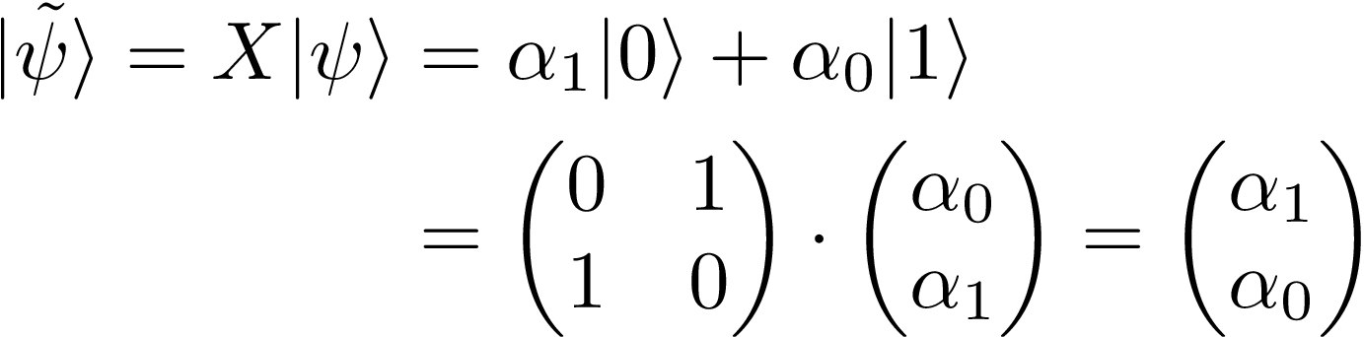
The Schrödinger Method

Slide 5
The Schrödinger Method

Slide 6
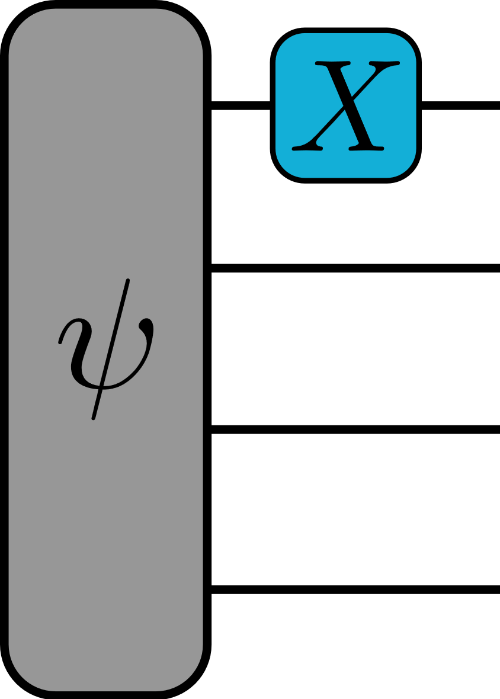
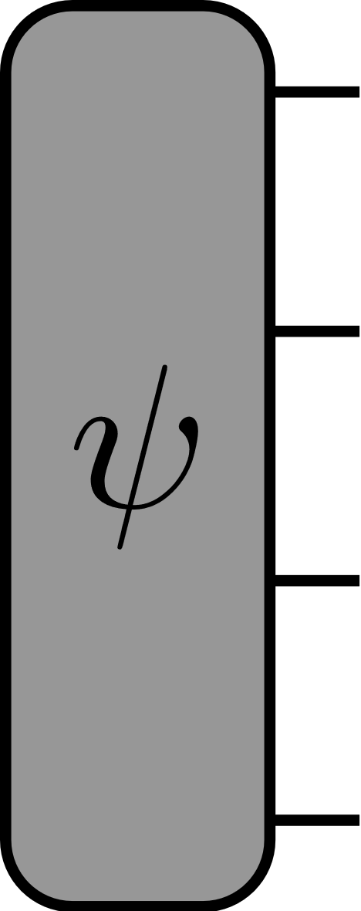
The Schrödinger Method

Slide 7
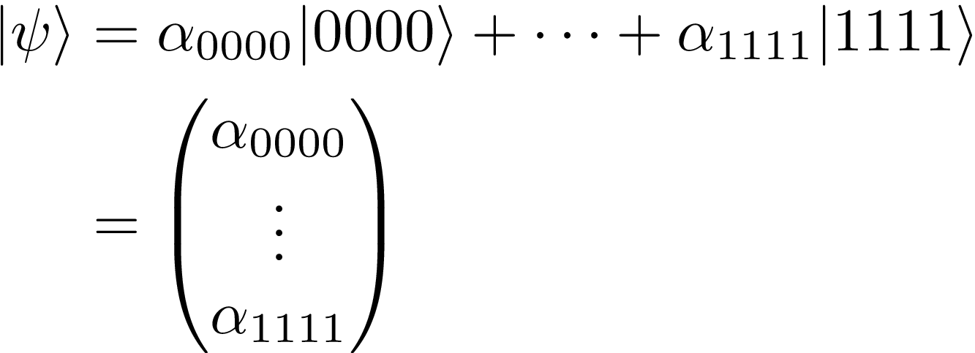
The Schrödinger Method

Slide 8
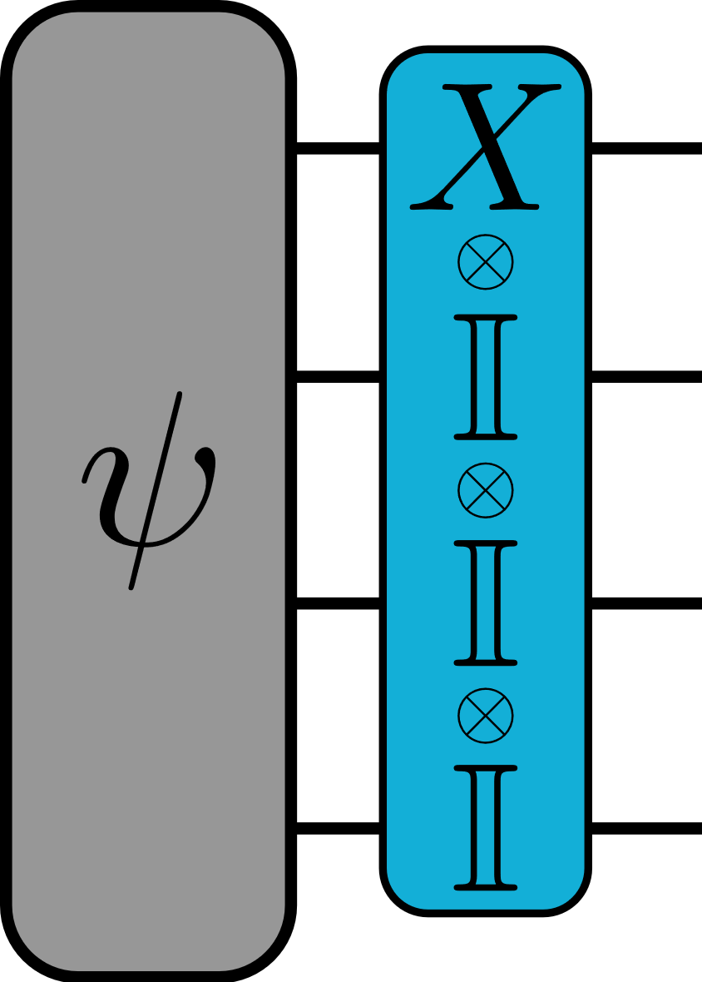
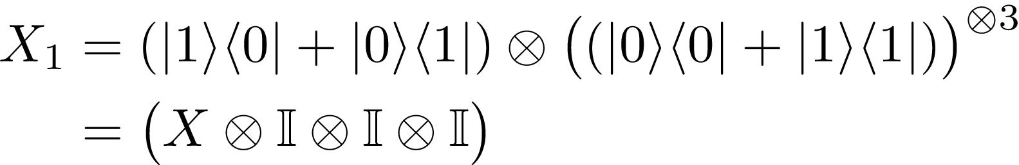
The Schrödinger Method

Slide 9
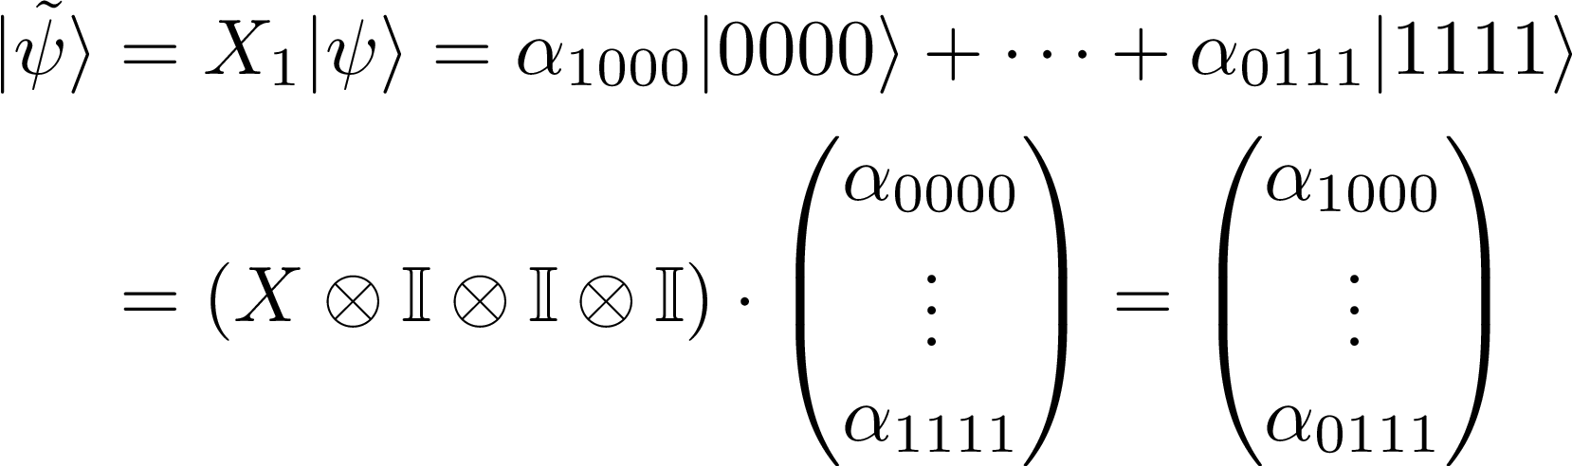
The Schrödinger Method

Slide 10
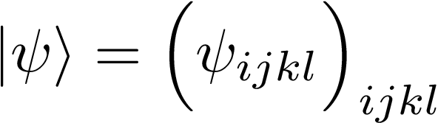

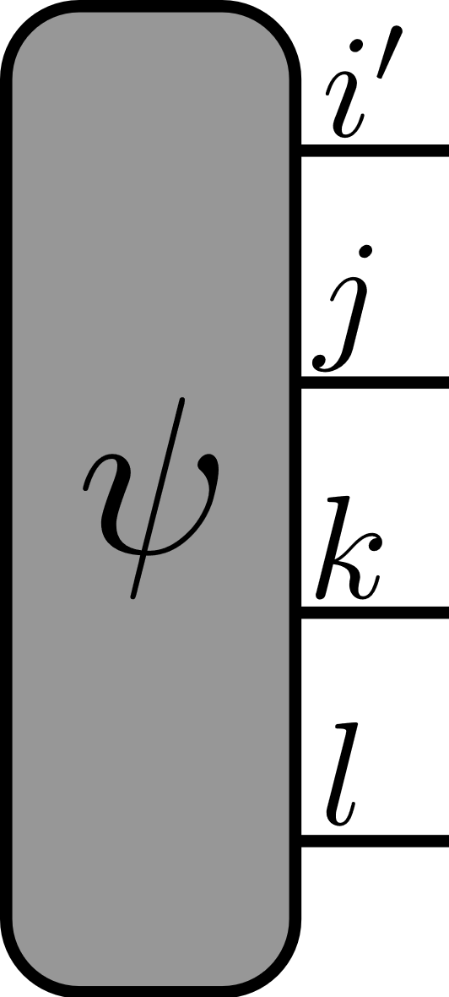
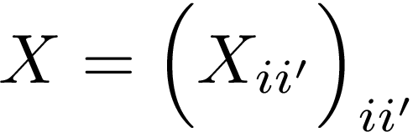
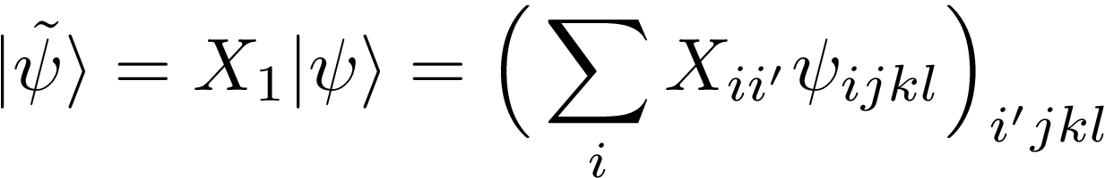
The Schrödinger Method

Slide 11
The Schrödinger Method

Slide 12
The Schrödinger Method - Benchmarks

Slide 13
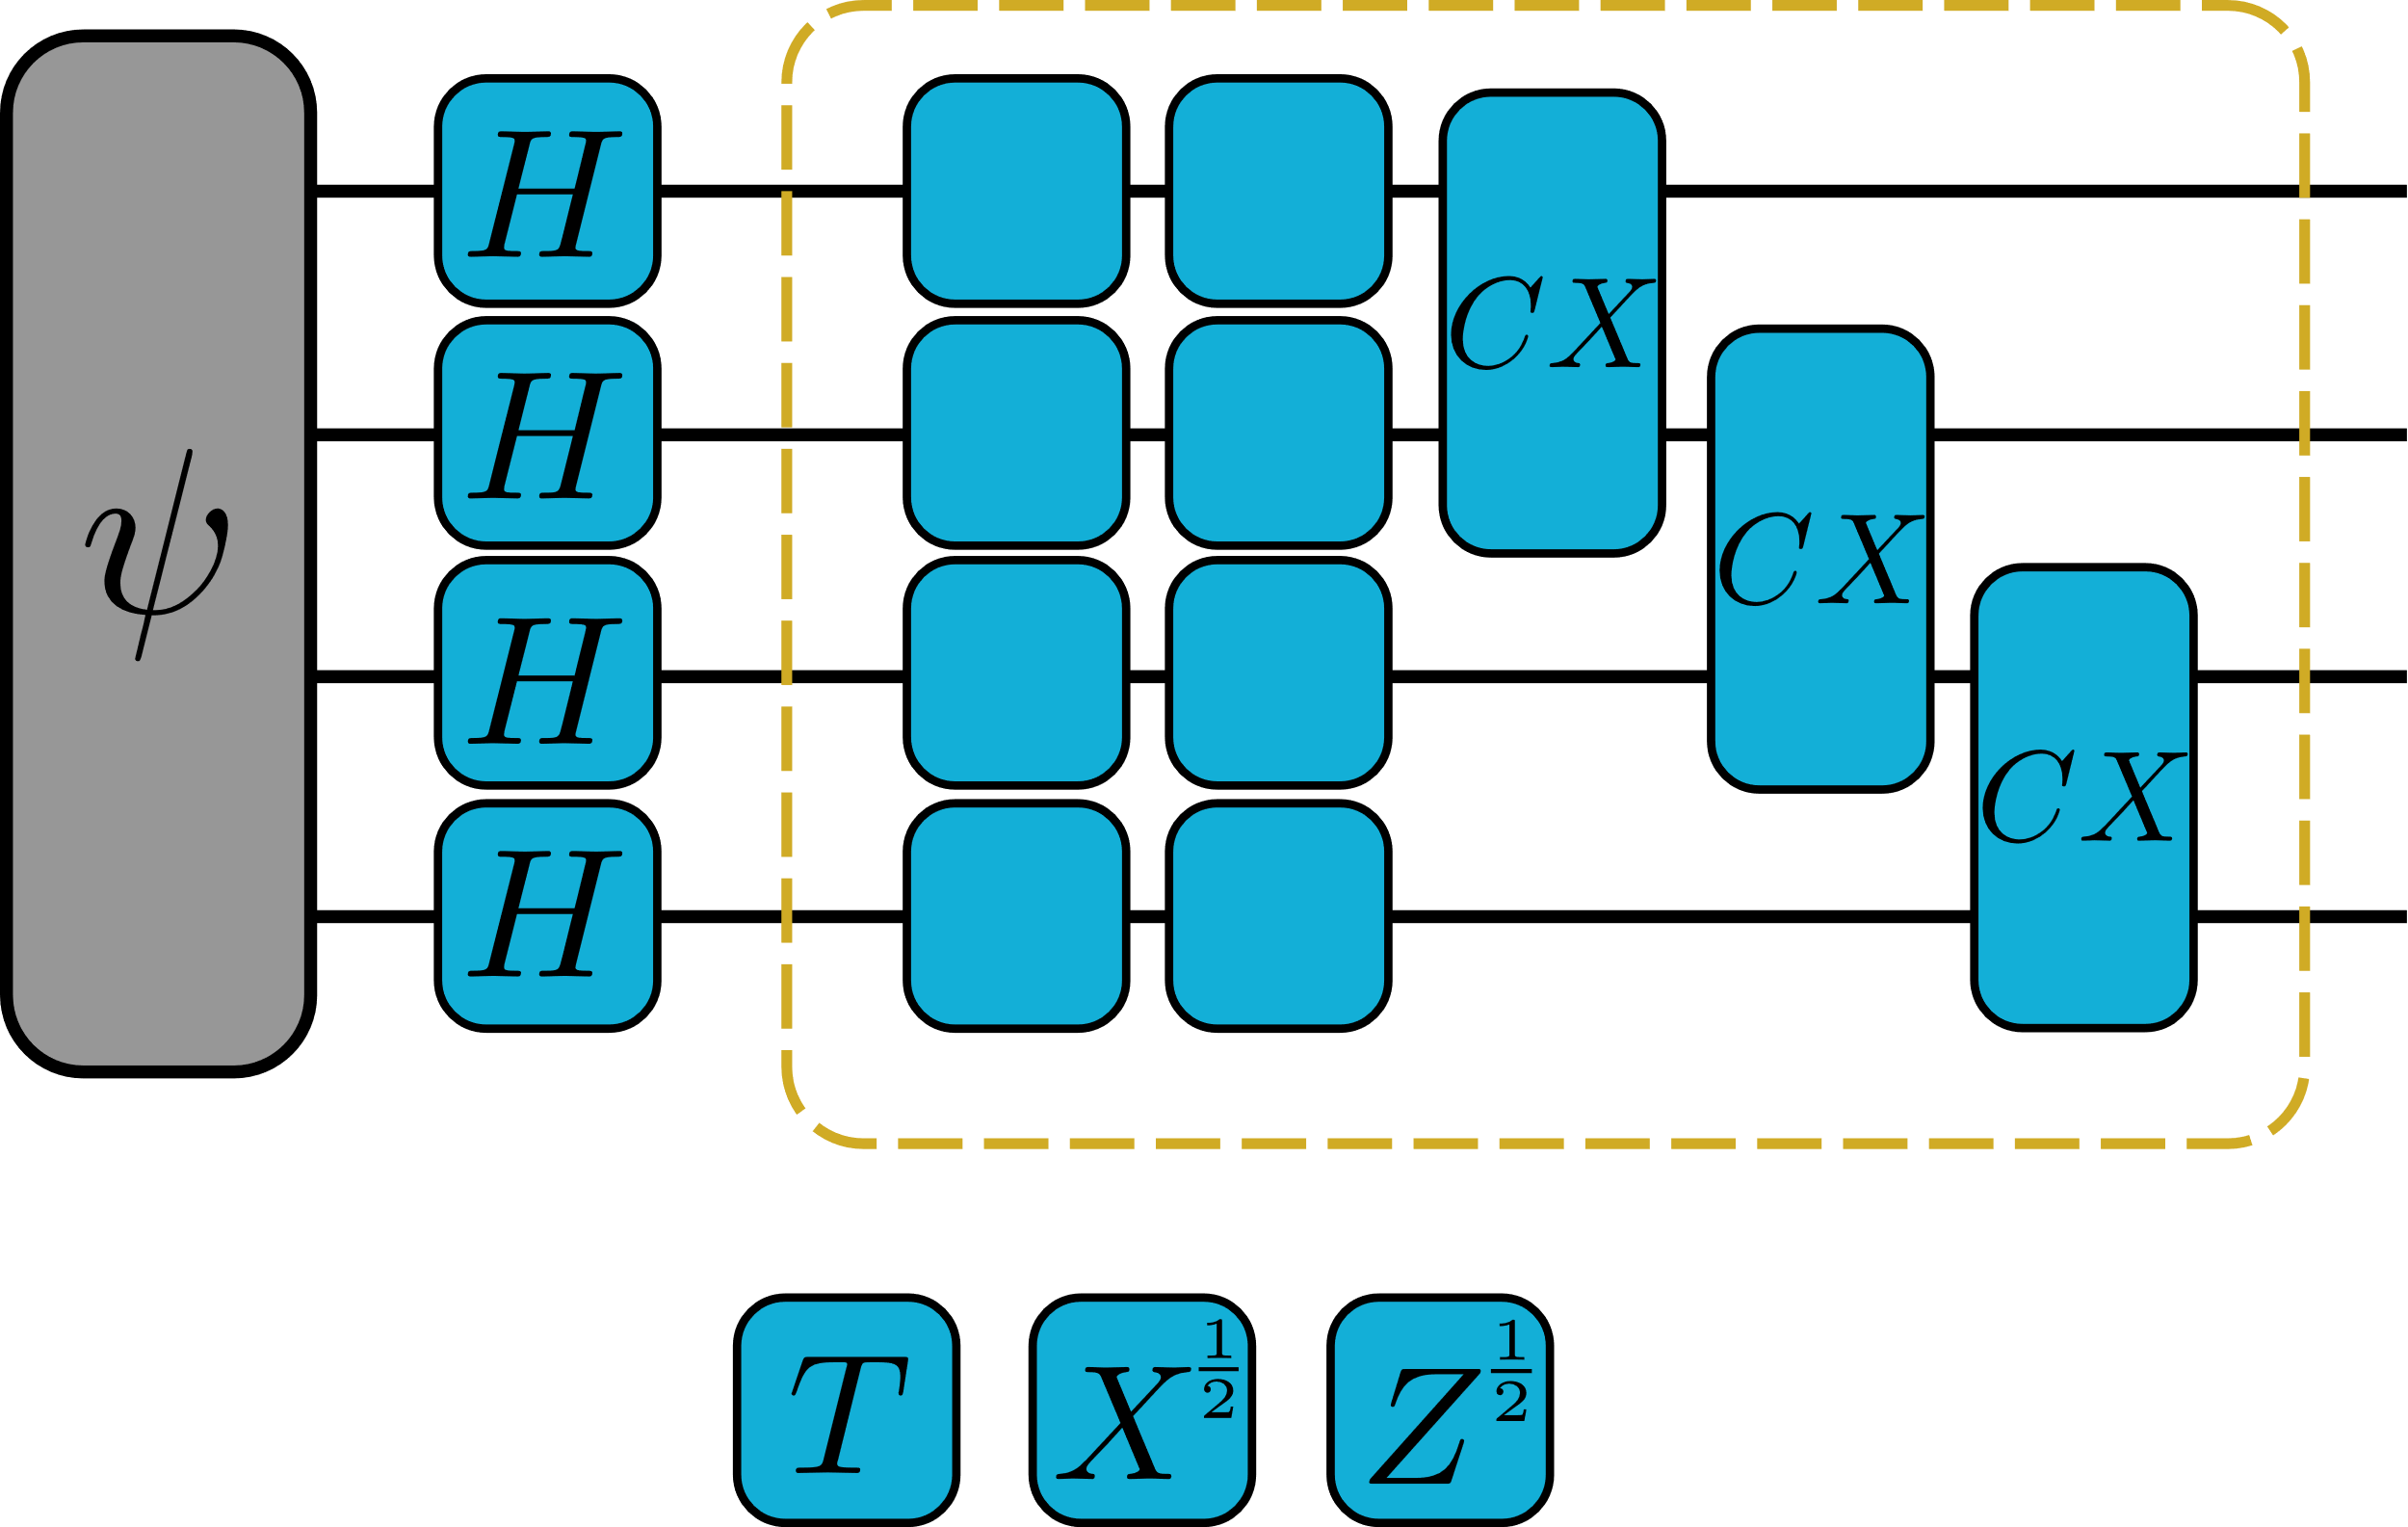
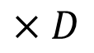
The Schrödinger Method - Benchmarks
$$×D$$

Slide 14
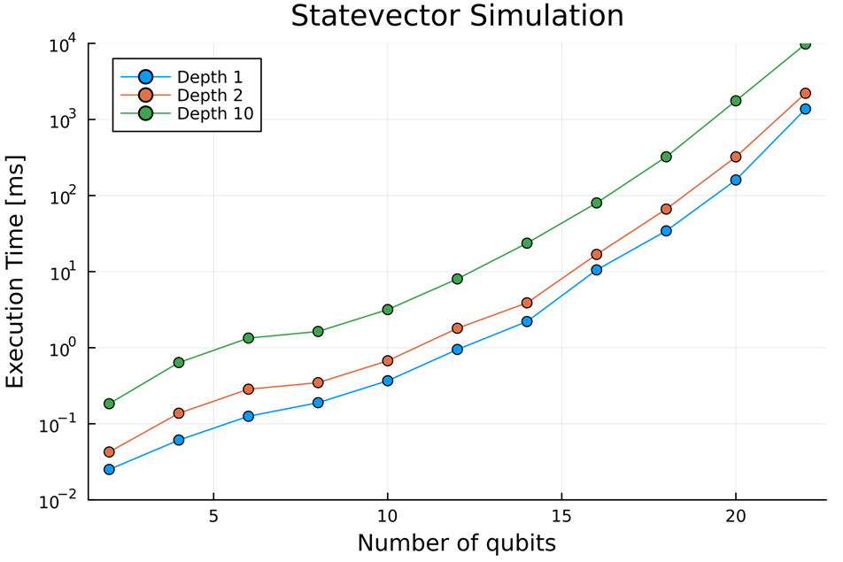
The Schrödinger Method - Benchmarks

Slide 15
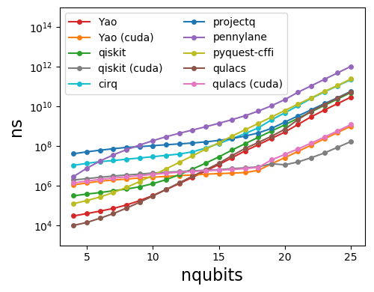
The Schrödinger Method - Benchmarks
github.com/yardstiq/quantum-benchmarks

Slide 16
The Feynman Method

Slide 17
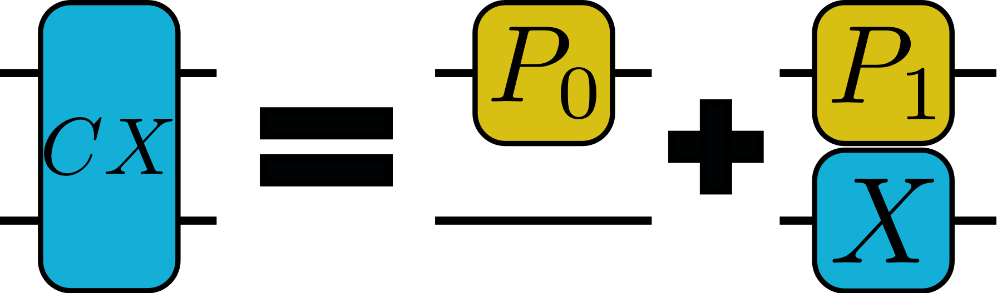
The Feynman Method

Slide 18
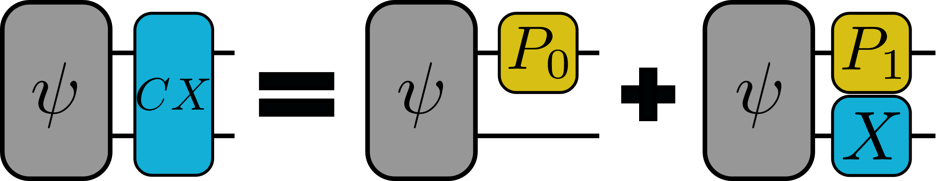
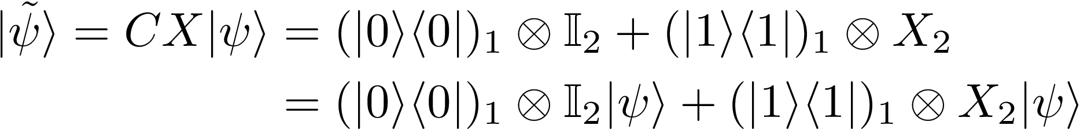
The Feynman Method

Slide 19
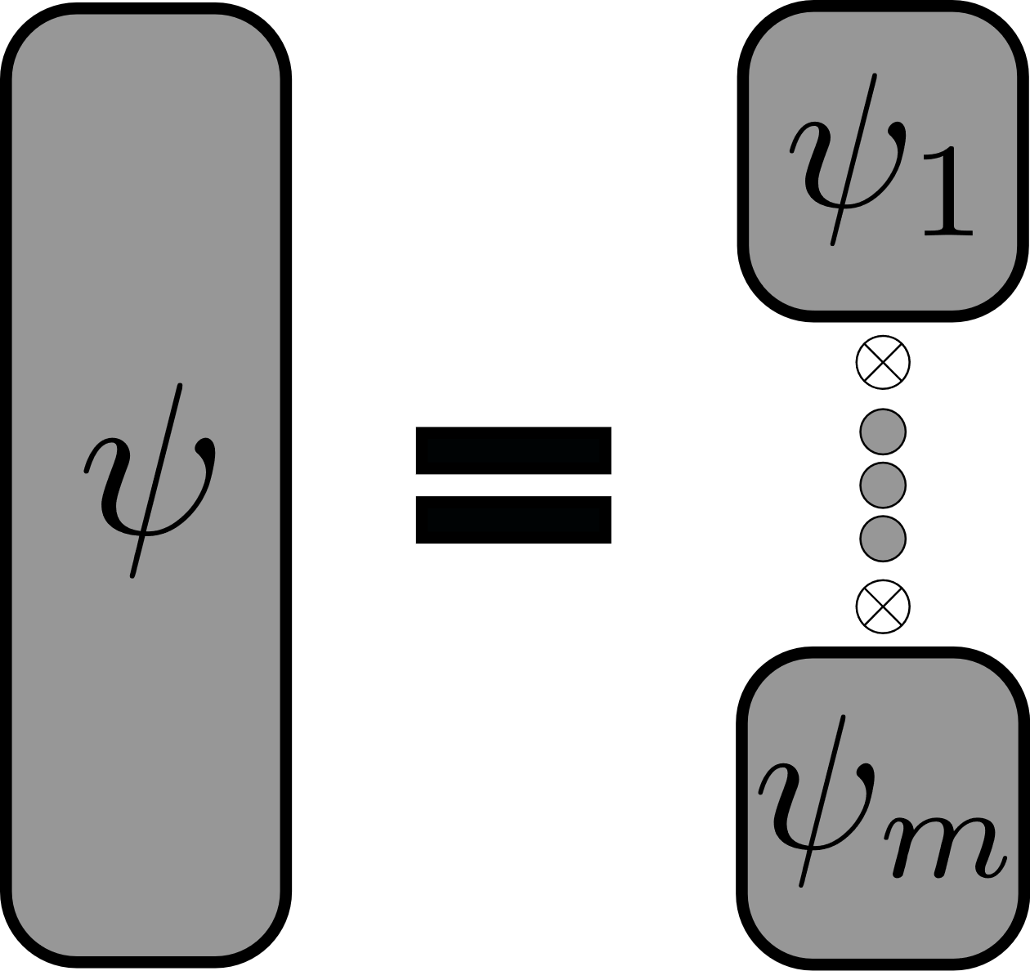
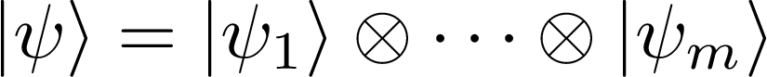
The Schrödinger-Feynman Method

Slide 20
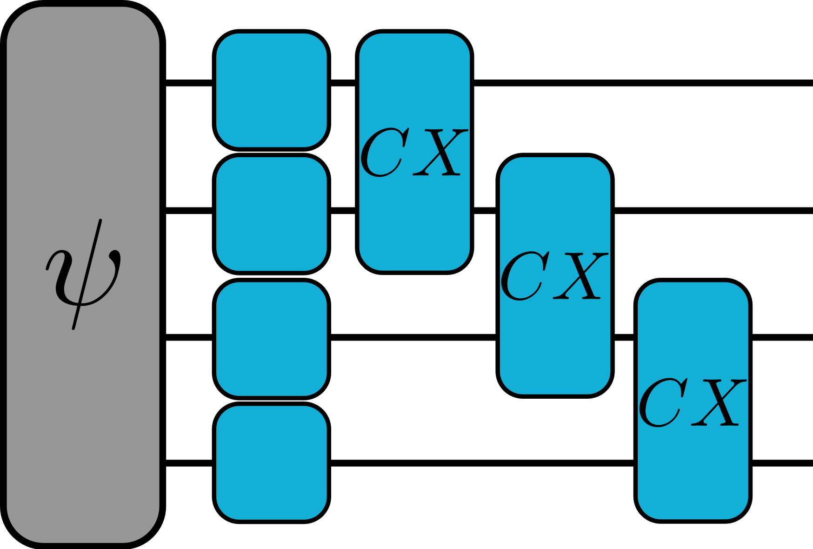
The Schrödinger-Feynman Method

Slide 21
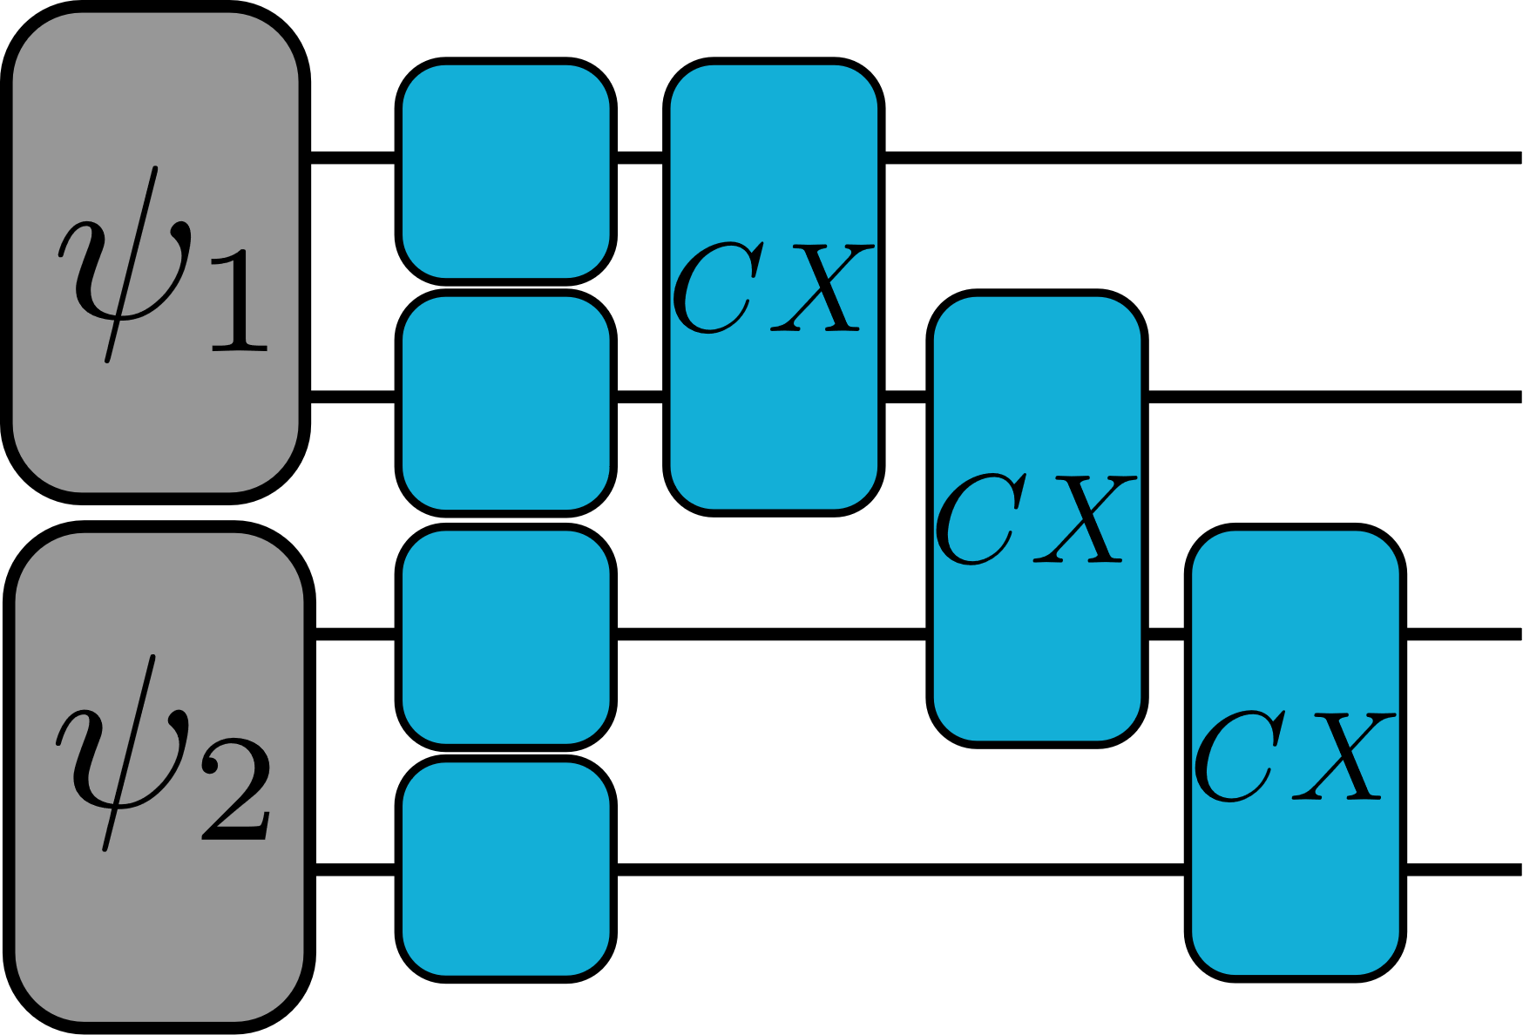
The Schrödinger-Feynman Method

Slide 22
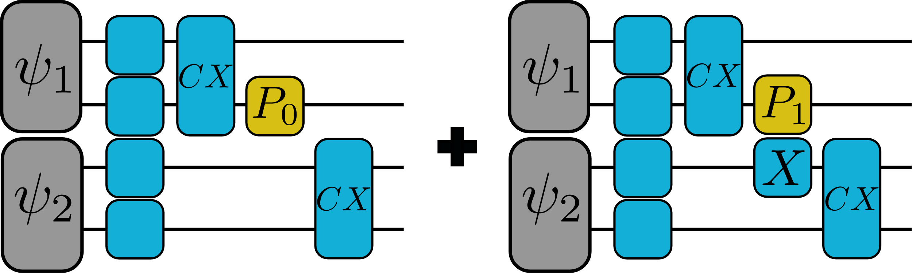
The Schrödinger-Feynman Method

Slide 23
The S-F Method - Benchmarks
$$×D$$

Slide 24
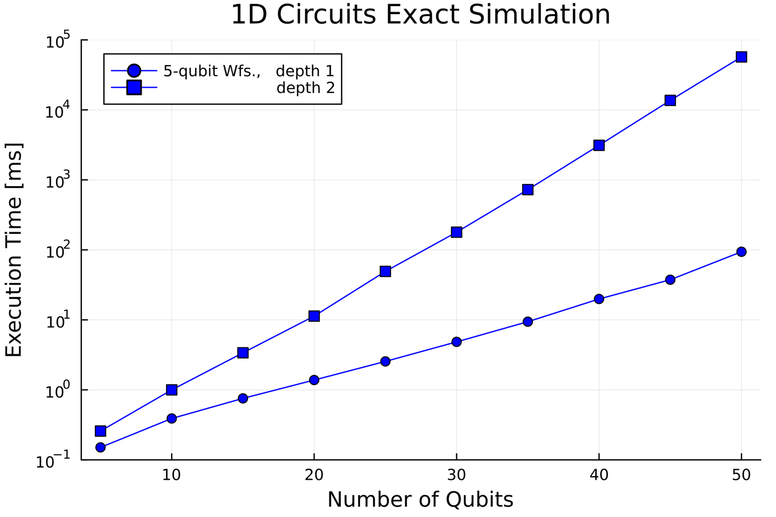
The S-F Method - Benchmarks

Slide 25

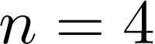
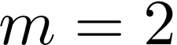

The S-F Method - Optimizing Memory

Slide 26
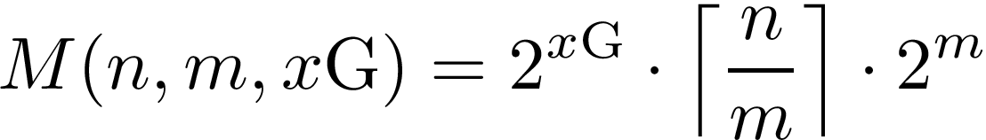
The S-F Method - Optimizing Memory

Slide 27
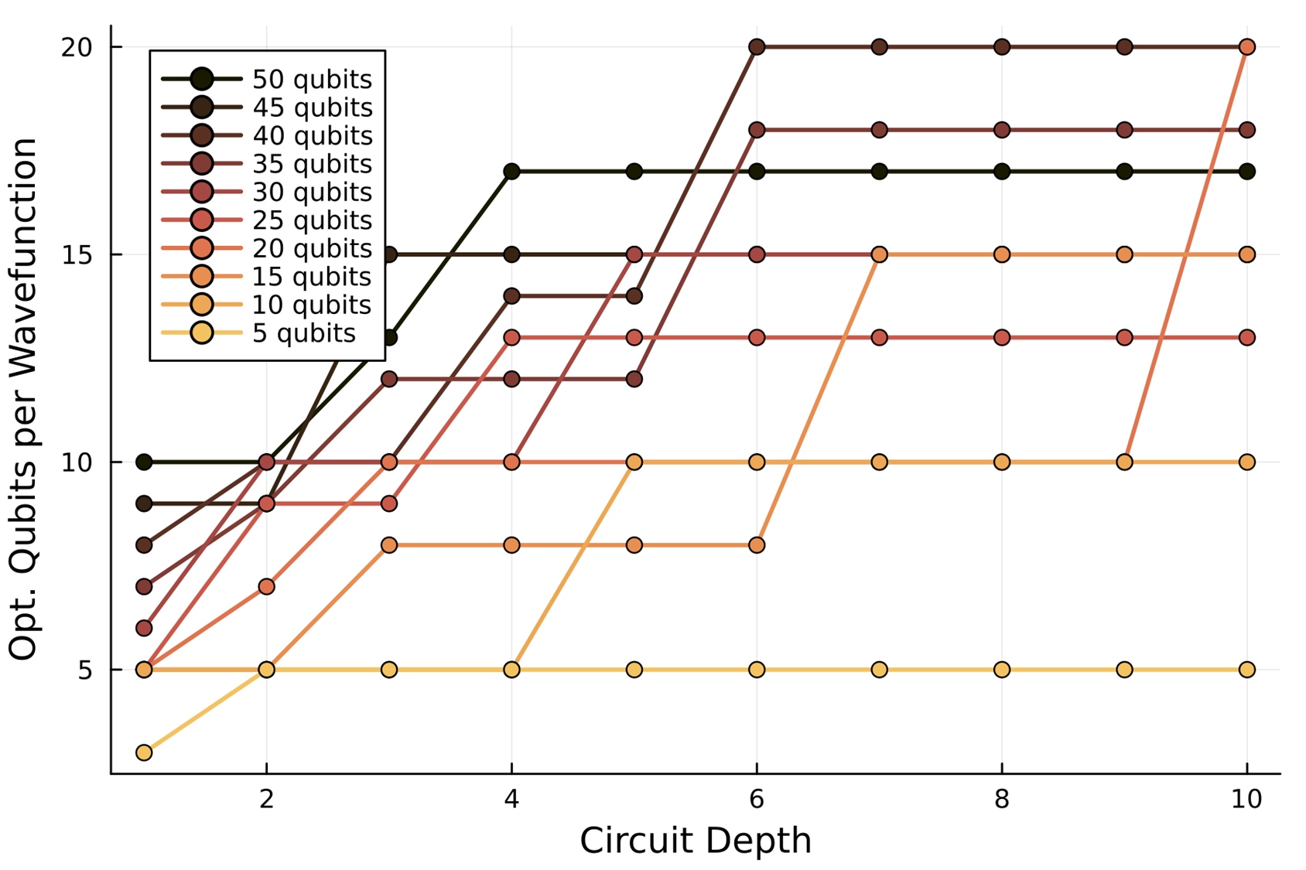
The S-F Method - Optimizing Memory

Slide 28
The S-F Method - Optimizing Memory

Slide 29
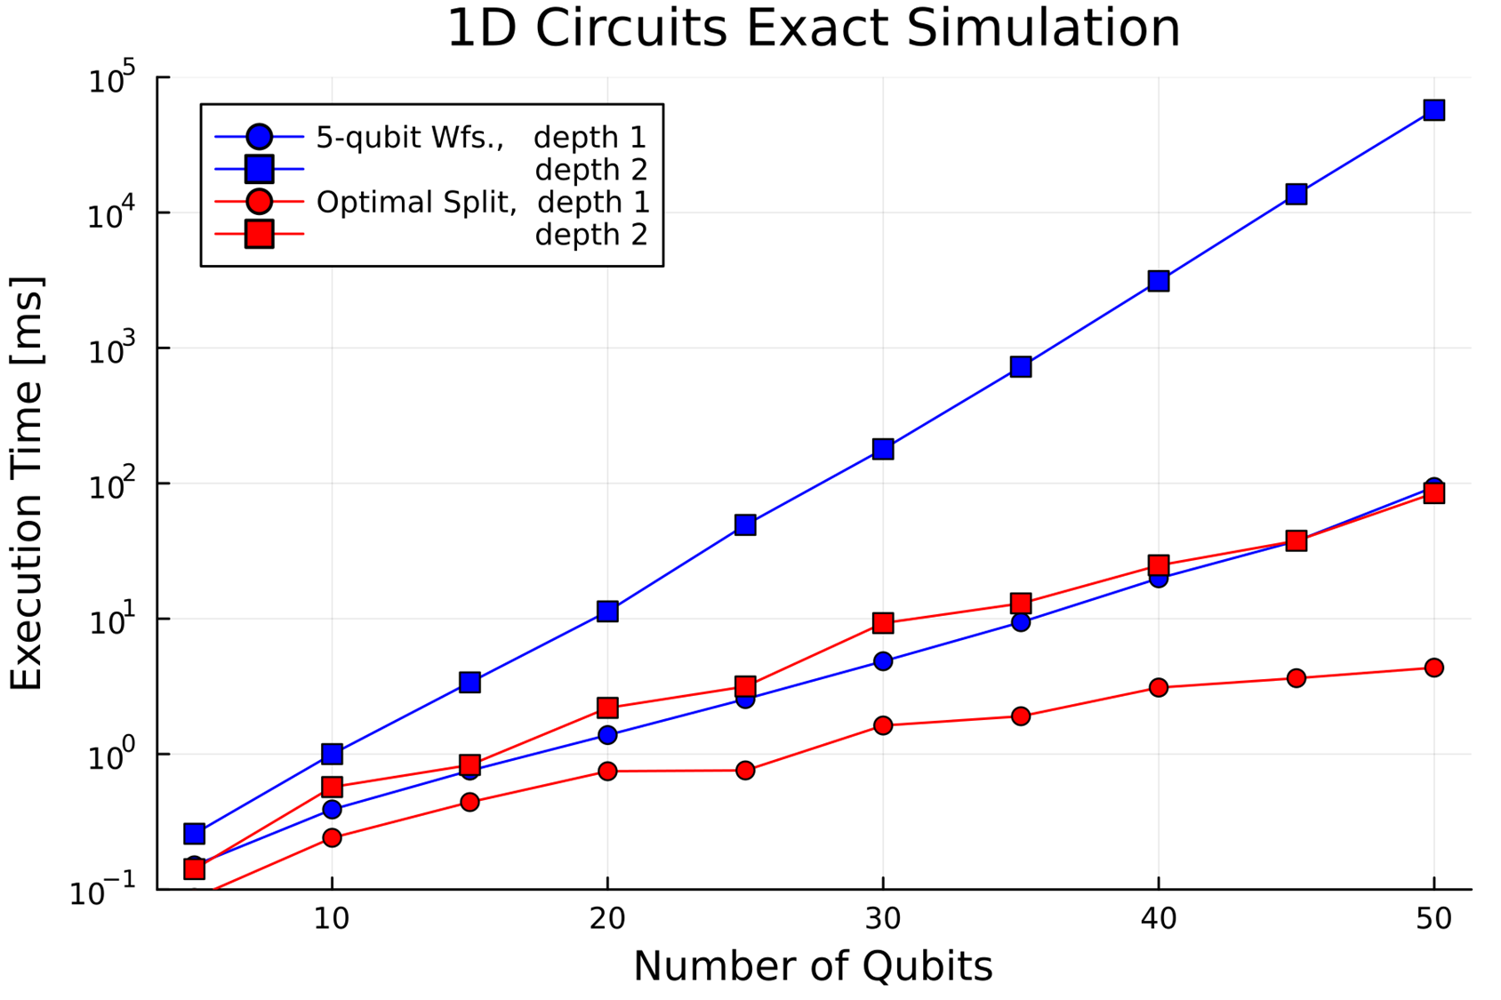
The S-F Method - Optimizing Memory

Slide 30
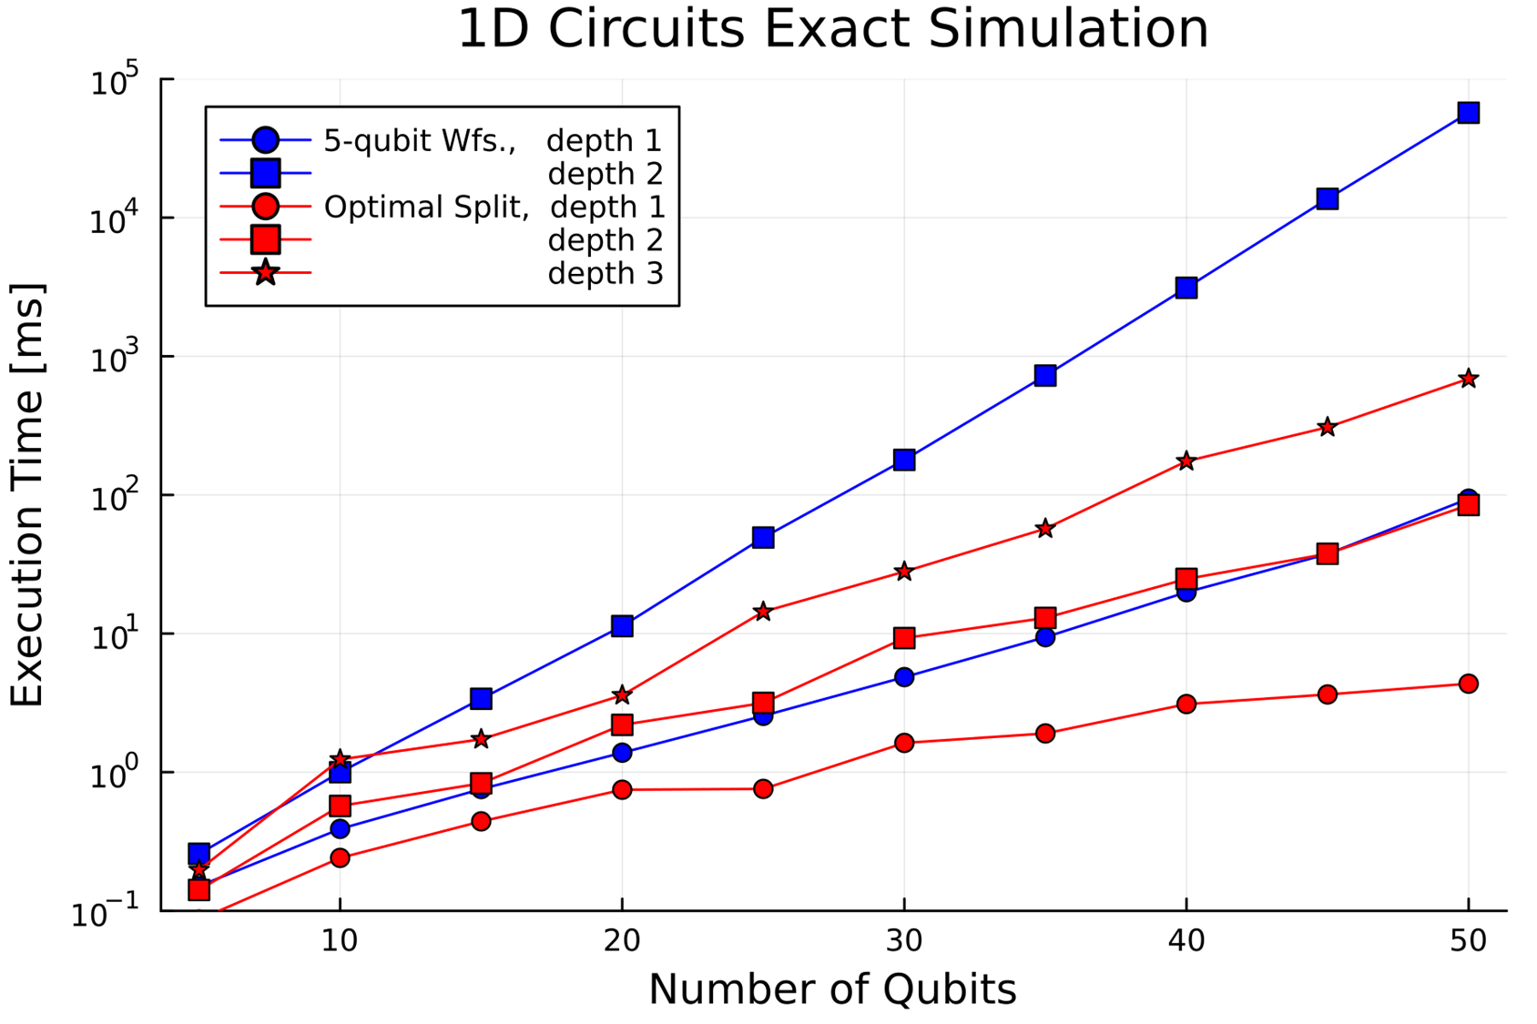
The S-F Method - Optimizing Memory

Slide 31
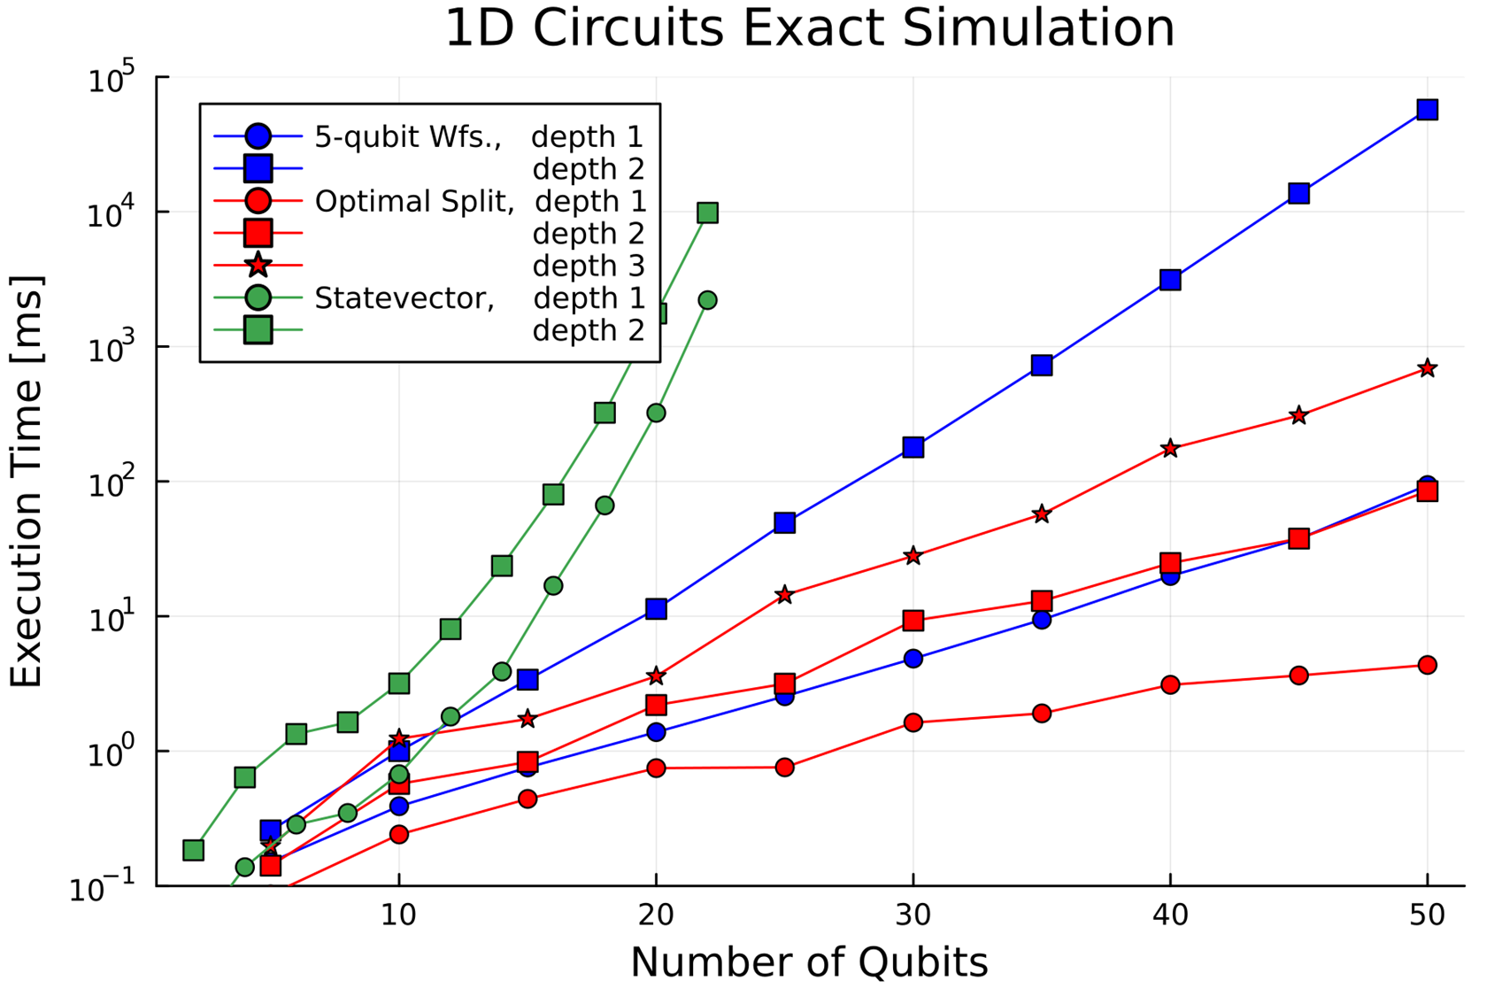
The S-F Method - Optimizing Memory

Slide 32


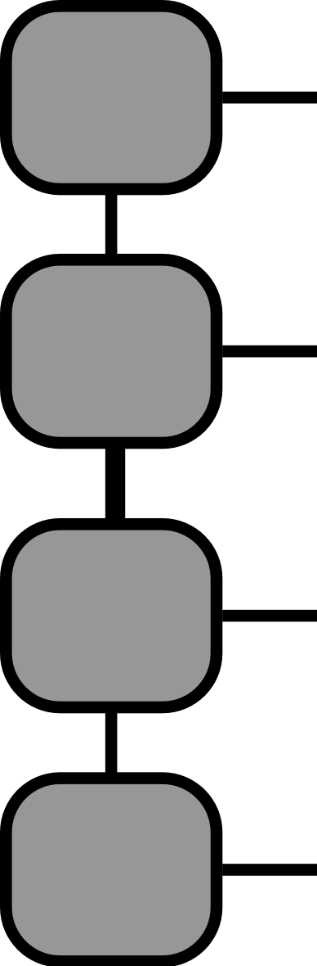

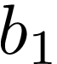
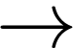
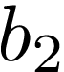


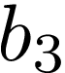
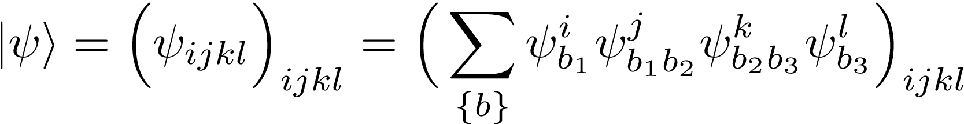
Matrix Product States

Slide 33
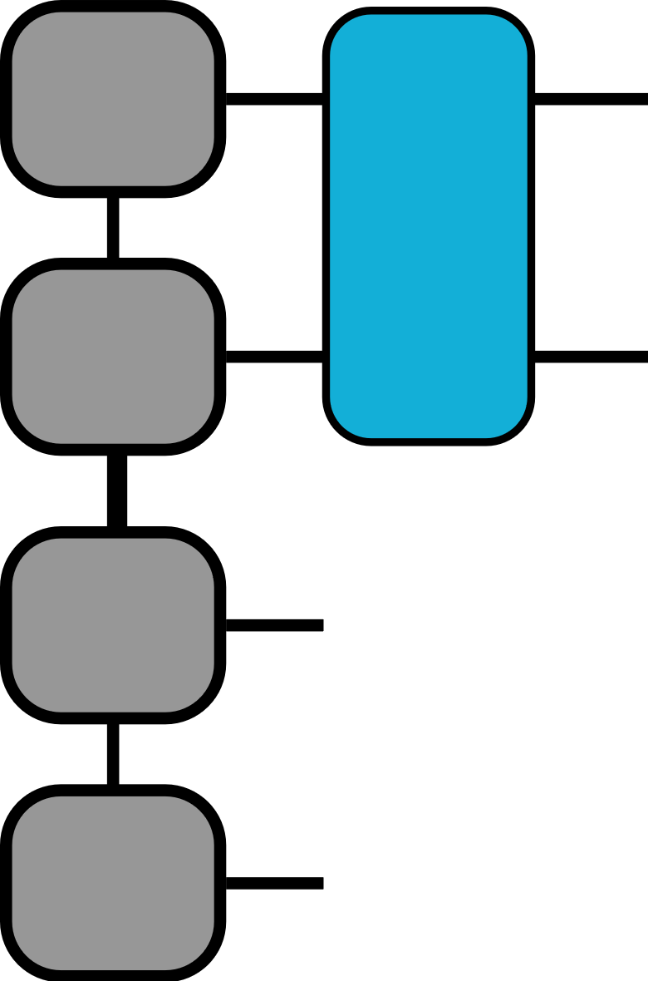
Matrix Product States

Slide 34
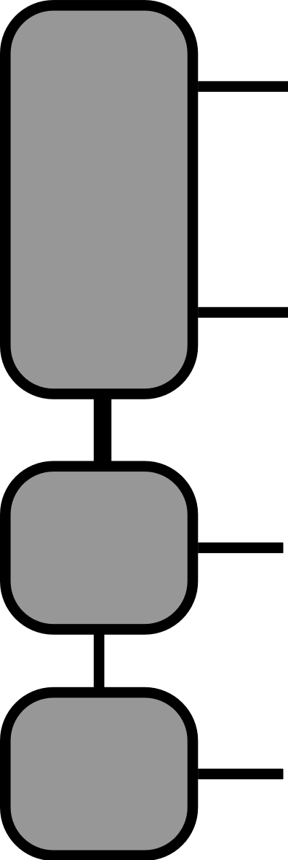
Matrix Product States
contract

Slide 35
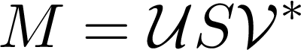
Matrix Product States
SVD

Slide 36
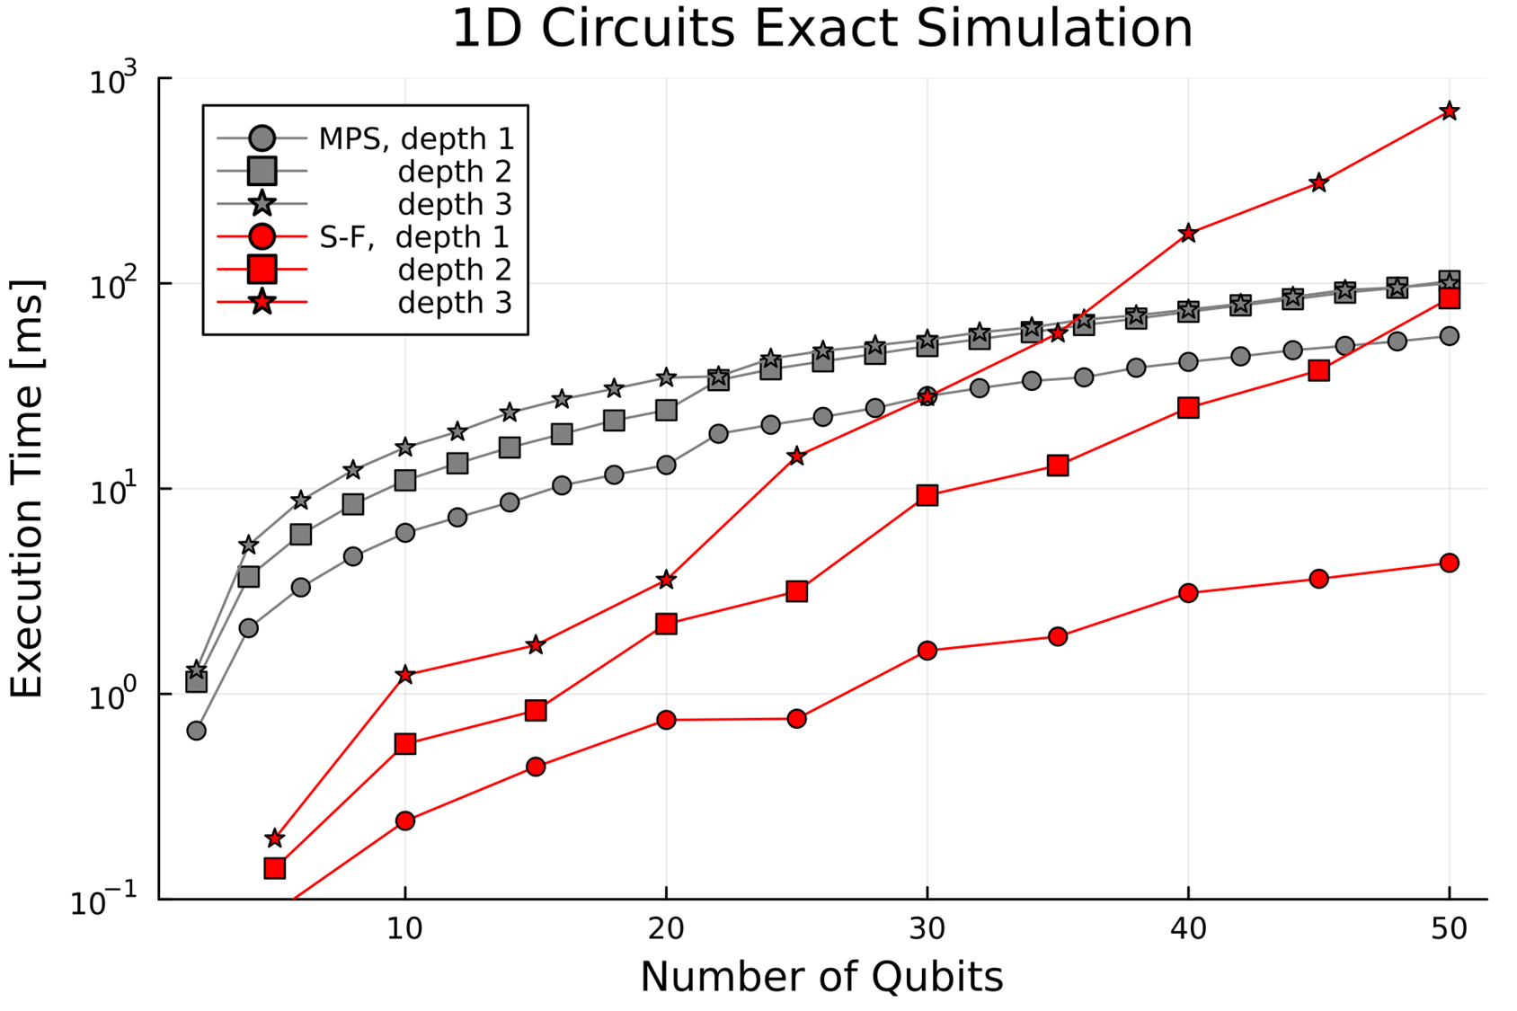
Matrix Product States - Benchmarks

Slide 37
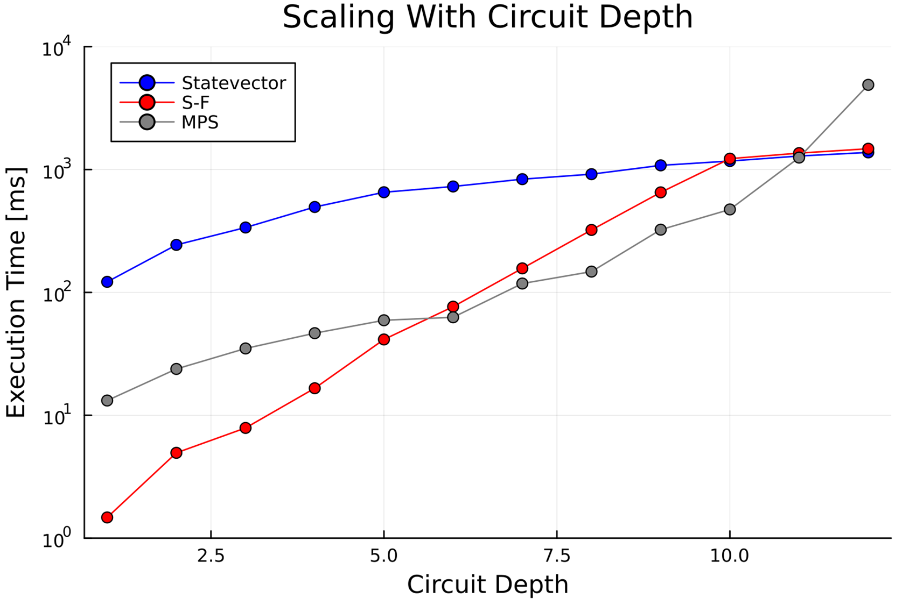
Scaling with Depth
at 20 qubits

Slide 38
2D Benchmarks

Slide 39
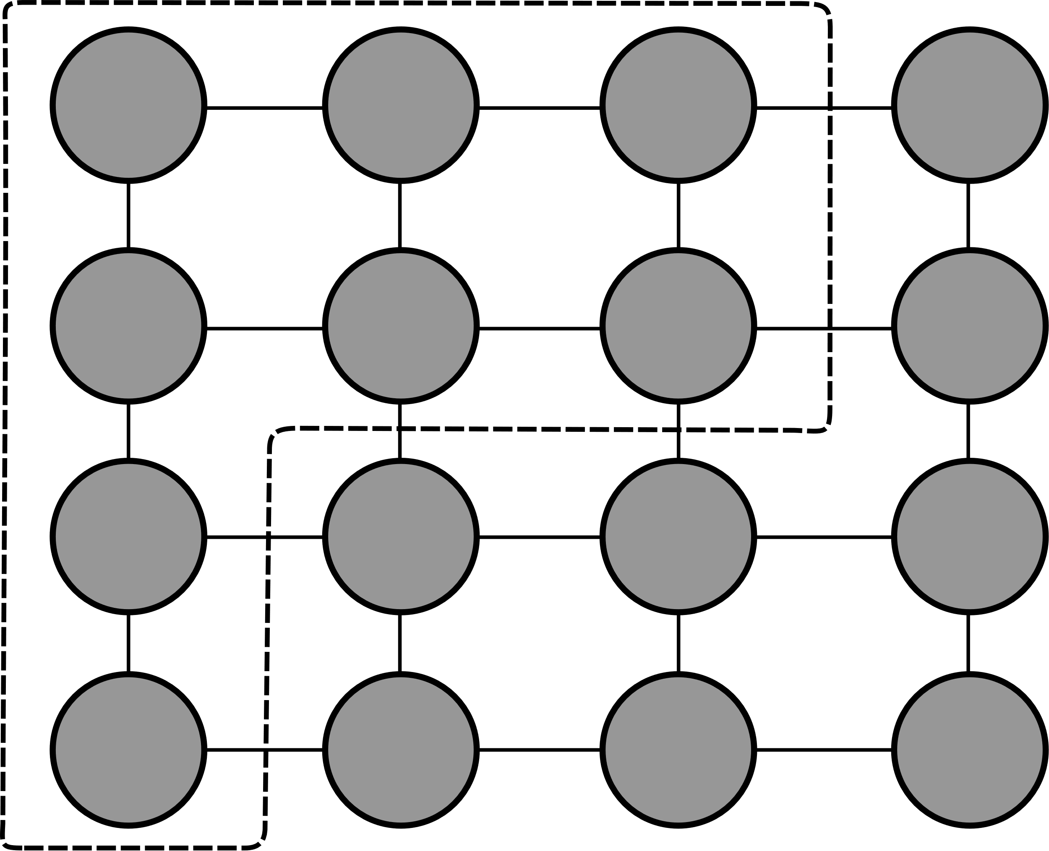
2D Benchmarks

Slide 40
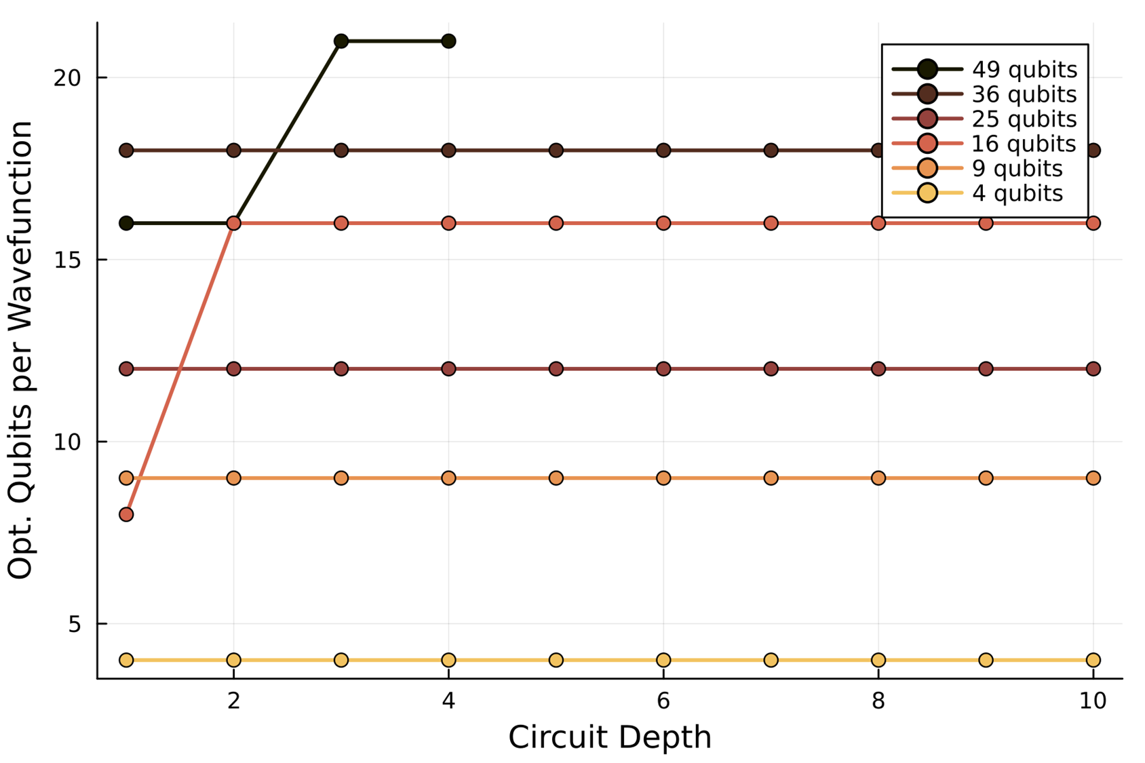
2D Benchmarks

Slide 41
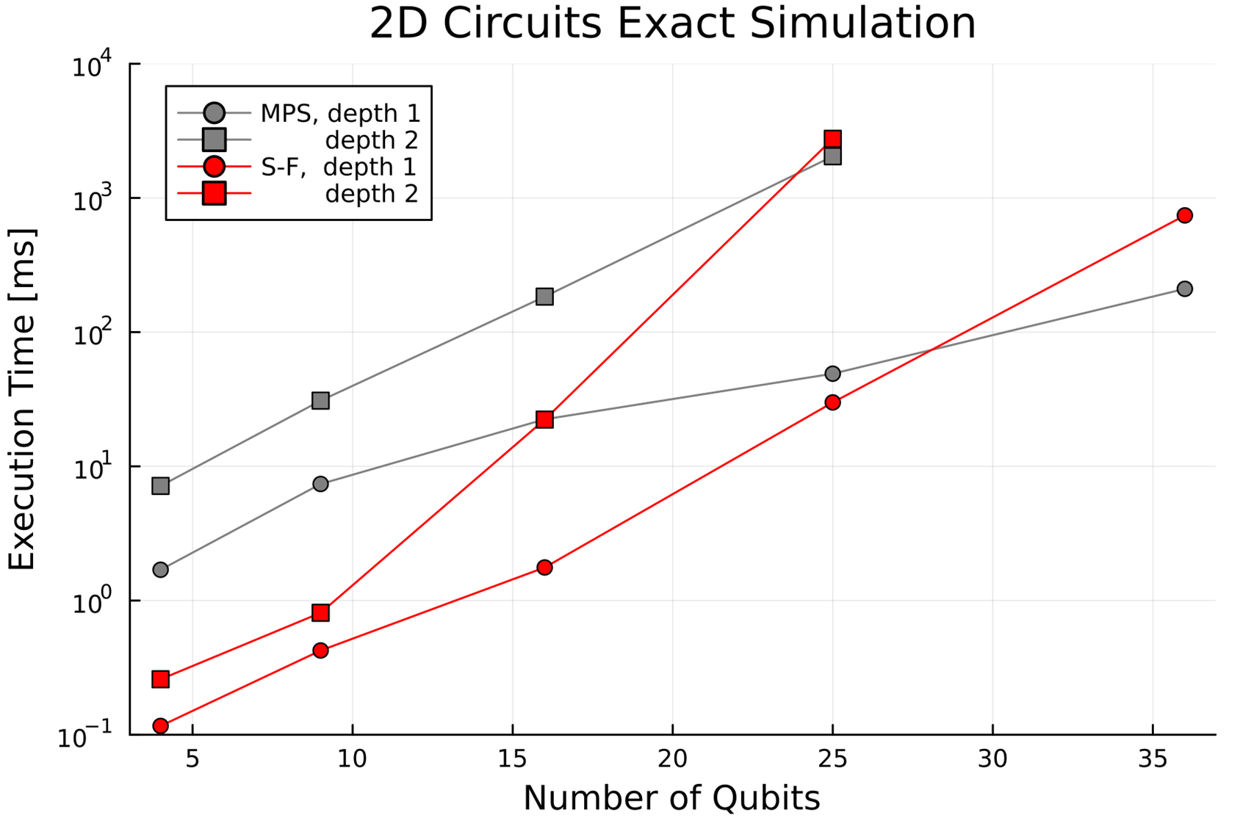
2D Benchmarks

Slide 42
Finite Fidelity

Slide 43
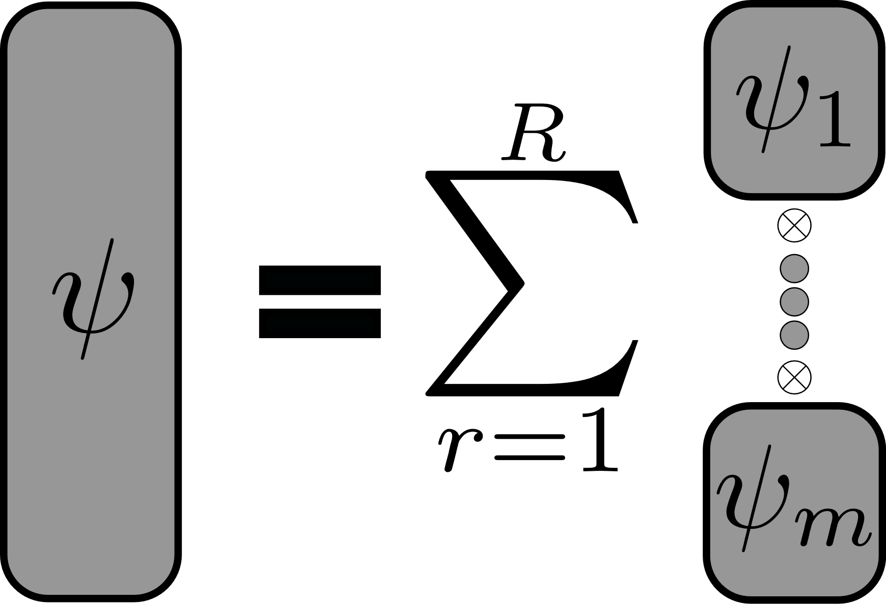
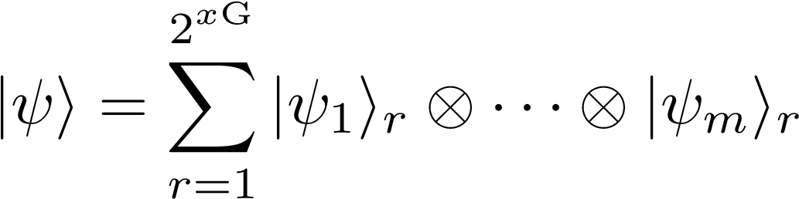
Finite Fidelity

Slide 44

Finite Fidelity

Slide 45

Finite Fidelity

Slide 46


Finite Fidelity - 1D Circuits

Slide 47


Finite Fidelity - 2D Circuits

Slide 48
Conclusions
Open Question/ Future Work
S-F optimal at very short depth
S-F applicable to non-1D/tree
Random circuits worst case for MPS
RAM & save/load crucial
Naive truncation unsatisfactory
https://github.com/MSRudolph/Schroedinger-Feynman-TNs

Slide 49
Conclusions
Open Question/ Future Work
S-F optimal at very short depth
S-F applicable to non-1D/tree
Random circuits worst case for MPS
RAM & save/load crucial
Naive truncation unsatisfactory
Find use-cases over TN methods
Intricate topologies
Density matrix simulation
Implement sparse mats. & save/load
Informed truncation of replica
Measuring norm
Parametrized circuits
https://github.com/MSRudolph/Schroedinger-Feynman-TNs

Slide 50
Conclusions
Open Question/ Future Work
S-F optimal at very short depth
S-F applicable to non-1D/tree
Random circuits worst case for MPS
RAM & save/load crucial
Naive truncation unsatisfactory
Find use-cases over TN methods
Intricate topologies
Density matrix simulation
Implement sparse mats. & save/load
Informed truncation of replica
Measuring norm
Parametrized circuits
https://github.com/MSRudolph/Schroedinger-Feynman-TNs

Slide 51
Conclusions
Open Question/ Future Work
S-F optimal at very short depth
S-F applicable to non-1D/tree
Random circuits worst case for MPS
RAM & save/load crucial
Naive truncation unsatisfactory
Find use-cases over TN methods
Intricate topologies
Density matrix simulation
Implement sparse mats. & save/load
Informed truncation of replica
Measuring norm
Parametrized circuits
https://github.com/MSRudolph/Schroedinger-Feynman-TNs

Slide 52


Slide 53

Finite Fidelity

Slide 54

Sampling

Slide 55

Sampling

Slide 56

Thomas Porter Distribution

Slide 57

Harder Two-Qubit Gates

